Slide 1
Apache Storm Architecture
Pravin Y Pawar

Slide 2
Apache Storm
created by Nathan Marz and team
at BackType (then acquired by Twitter)
standard for distributed real-time processing system
allows you to process large amount of data
is written in Java and Clojure
is stateless, it manages distributed environment and cluster state via Apache ZooKeeper
Is leader in real-time analytics
easy to setup, operate and it guarantees that every message will be processed through the topology at least once

Slide 3
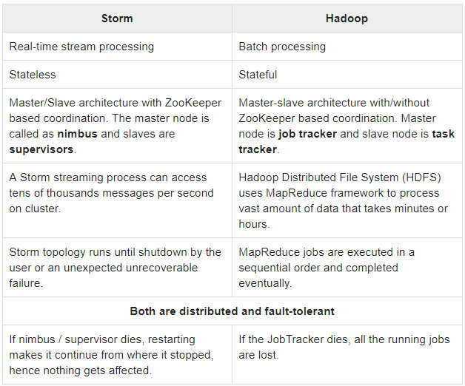
Storm Vs Hadoop
Source : Tutorial Point

Slide 4
Storm Benefits
open source, robust, and user friendly
fault tolerant, flexible, reliable
allows real-time stream processing
keep up the performance even under increasing load by adding resources linearly, highly scalable.
provides guaranteed data processing even if any of the connected nodes in the cluster die or messages are lost

Slide 5
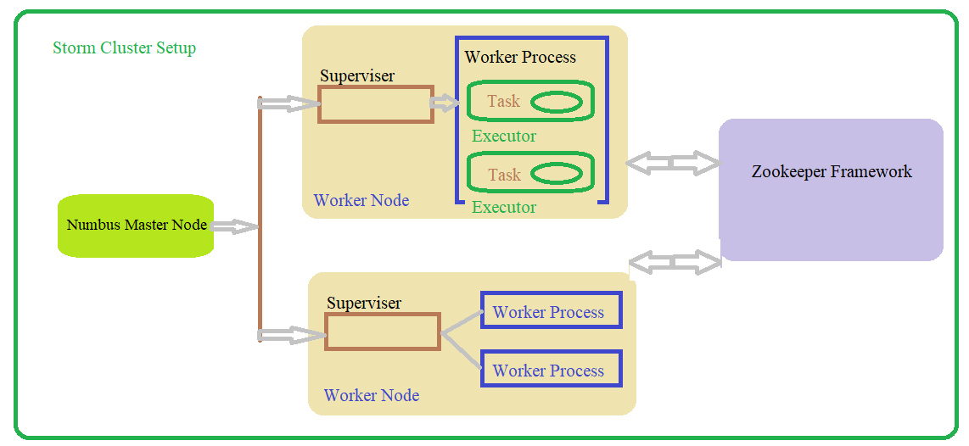
Apache Storm Cluster

Slide 6
Apache Storm Cluster(2)
Nimbus
Master node of Storm cluster
All other nodes in the cluster are called as worker nodes
is responsible for distributing data among all the worker nodes, assign tasks to worker nodes and monitoring failures.
Supervisor
The nodes that follow instructions given by the nimbus are called as Supervisors.
A supervisor has multiple worker processes and it governs worker processes to complete the tasks assigned by the nimbus.

Slide 7
Apache Storm Cluster(3)
Worker process
executes tasks related to a specific topology
A worker process will not run a task by itself, instead it creates executors and asks them to perform a particular task.
A worker process will have multiple executors.
Executor
nothing but a single thread spawn by a worker process
An executor runs one or more tasks but only for a specific spout or bolt.
Task
A task performs actual data processing. So, it is either a spout or a bolt.

Slide 8
Storm Workflow
Initially, the nimbus will wait for the “Storm Topology” to be submitted to it.
Once a topology is submitted, it will process the topology and gather all the tasks that are to be carried out and the order in which the task is to be executed.
The nimbus will evenly distribute the tasks to all the available supervisors.
At a particular time interval, all supervisors will send heartbeats to the nimbus to inform that they are still alive.
When a supervisor dies and doesn’t send a heartbeat to the nimbus, then the nimbus assigns the tasks to another supervisor.
When the nimbus itself dies, supervisors will work on the already assigned task without any issue.
Once all the tasks are completed, the supervisor will wait for a new task to come in.
In the meantime, the dead nimbus will be restarted automatically by service monitoring tools.
The restarted nimbus will continue from where it stopped.
Once all the topologies are processed, the nimbus waits for a new topology to arrive and similarly the supervisor waits for new tasks.

Slide 9
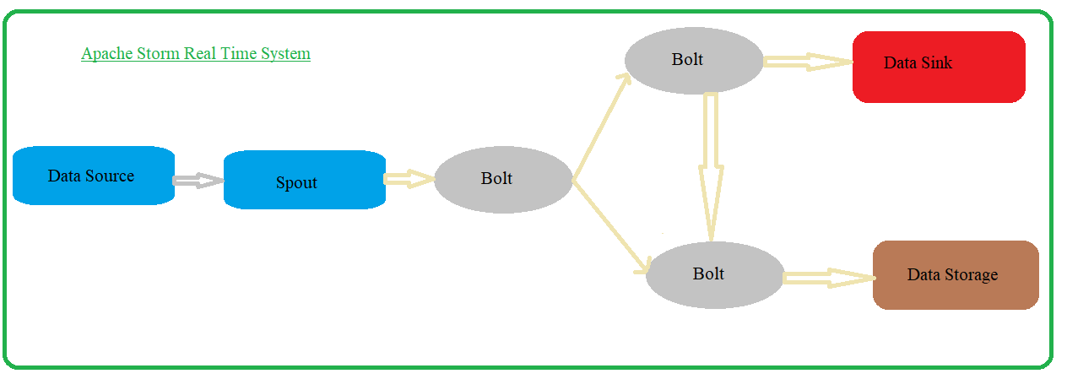
Apache Storm System

Slide 10
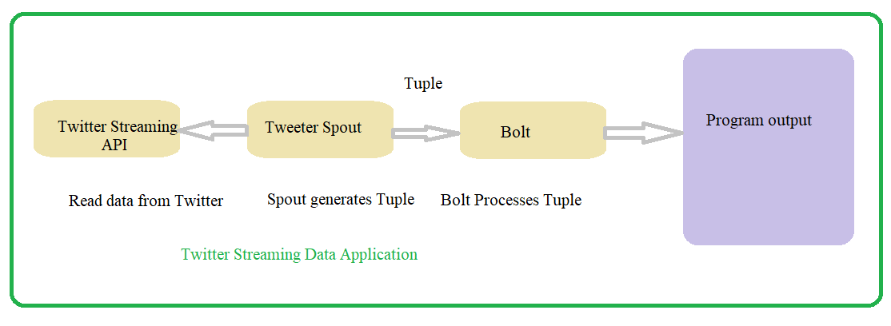
Apache Storm System(2)
Components
Stream
Tuple
Spout
Bolt

Slide 11
Apache Storm System Components
Stream
sequence of tuples
Tuple
main data structure in Storm
a list of ordered elements
modelled as a set of comma separated values and passed to a Storm cluster

Slide 12
Apache Storm System Components(2)
Spouts
Source of stream
accepts input data from raw data sources like Twitter Streaming API, Apache Kafka etc.
can read data from other data sources
“ISpout" is the core interface for implementing spouts
Specific interfaces are IRichSpout, BaseRichSpout, KafkaSpout etc.

Slide 13
Apache Storm System Components(3)
Bolts
logical processing units
Spouts pass data to bolts and bolts process and produce a new output stream.
perform the operations of filtering, aggregation, joining, interacting with data sources and databases
receives data and emits to one or more bolts
“IBolt” is the core interface for implementing bolts
Common interfaces are IRichBolt, IBasicBolt, etc.

Slide 14
Apache Storm System Components(4)
Topology
Spouts and bolts are connected together and they form a topology
Application logic is specified inside Storm topology
is a directed graph where vertices are computation and edges are stream of data
Storm keeps the topology always running, until you kill the topology.
Apache Storm’s main job is to run the topology and will run any number of topology at a given time.

Slide 15
Apache Storm System Components(5)
A simple topology starts with spouts
Spout emits the data to one or more bolts
Bolt represents a node in the topology having the smallest processing logic
Output of a bolt can be emitted into another bolt as input

Slide 16
Thank You!

